Slide 1
Zoom In: An Introduction to Circuits
Olah, Cammarata, Schubert, Goh, Petrov & Carter (Distill, 2020)
Week 3 | AI Interpretability Reading Group | UC Berkeley Spring 2026
Will Fithian

Slide 2
Framing: Circuits for InceptionV1

Slide 3

The Anthropic Worldview
AI is powerful and potentially dangerous
We need to understand what’s happening inside these systems before we deploy them throughout the economy, government, society...
Interpretability as a safety bet
If we can reverse-engineer models, we might catch deception, misalignment, dangerous capabilities.
“Zoom In”: founding document of the “circuits” program
Olah et al. at OpenAI (later Anthropic) trying to do for neural networks what neuroscience did for brains.
The microscope analogy: a new instrument that lets us “zoom in” on the fine structure of learned representations, as Hooke’s Micrographia revealed cells.
From Hooke’s Micrographia (1665)

Slide 4
Why Vision Models?
Spatial structure
CNNs have local receptive fields, hierarchical composition, weight sharing — natural units for analysis.
Neuroscience precedent
Connects to decades of visual neuroscience (Hubel & Wiesel, 1962). Curve detectors have biological analogs.
Tractability
InceptionV1 has ~10,000 neurons. Small enough to hand-investigate, big enough to be interesting (won ImageNet 2014).

Slide 5
CNN Basics
Convolutional filters
Small patch (e.g. 3×3×C) slides across the image. Dot product at each position + nonlinearity produces a feature map. Many filters per layer → many channels output per pixel (3D tensor).
Hierarchical composition
Each layer operates on the previous layer’s output. Early: edges, color gradients. Later: complex combinations.
Spatial structure
Weight sharing (translation equivariance). Pooling reduces spatial dimensions.
“Neuron” = channel
~10,000 channels total in InceptionV1. Weight sharing means all spatial positions compute the same function.

Slide 6
InceptionV1 Architecture
Szegedy et al. (2015)
The Inception module
Parallel pathways of different filter sizes (1×1, 3×3, 5×5, pooling) that concatenate outputs along the channel dimension.
1×1 convolutions
Dimensionality reduction + cross-channel mixing. Much of the “feature combination” in circuits happens through 1×1 convs.
No skip connections
Information flows through every module in order. Unlike ResNets.
ImageNet
~1.2M images, 1000 categories, clean photos with single dominant subjects.
Layer naming
conv2d0, conv2d1, conv2d2
Initial conv layers
mixed3a, mixed3b
Early inception modules
mixed4a – mixed4e
Mid-level modules
mixed5a, mixed5b
Final modules
Numbers = spatial resolution stage
Letters = module within stage

Slide 7
The Circuits Vision and Results

Slide 8
Three Speculative Claims
1. Features
Neural networks have meaningful, interpretable features corresponding to directions in activation space.
2. Circuits
Features are connected by weights, forming circuits. These circuits can be rigorously studied and understood.
3. Universality
Analogous features and circuits form across different models and tasks.
All three are presented as deliberately speculative — modeled on Schwann’s 1839 claims about cells.

Slide 9
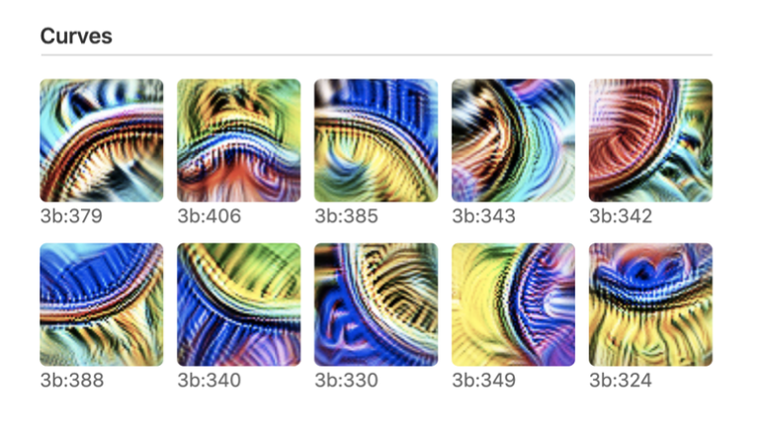
Main Example: Curve Detectors
Claim: Some channels in mixed3b are curve detectors — each tuned to a different orientation.
Line of evidence 1: Feature visualizations
Seven lines of evidence
1. Feature visualization
2. Dataset examples
3. Synthetic stimuli
4. Joint tuning curves
5. Circuit implementation
6. Downstream use
7. Handwritten circuits
From Olah et al. (2020), Figure: Curve detectors in mixed3b
How do we establish these are curve detectors?

Slide 10

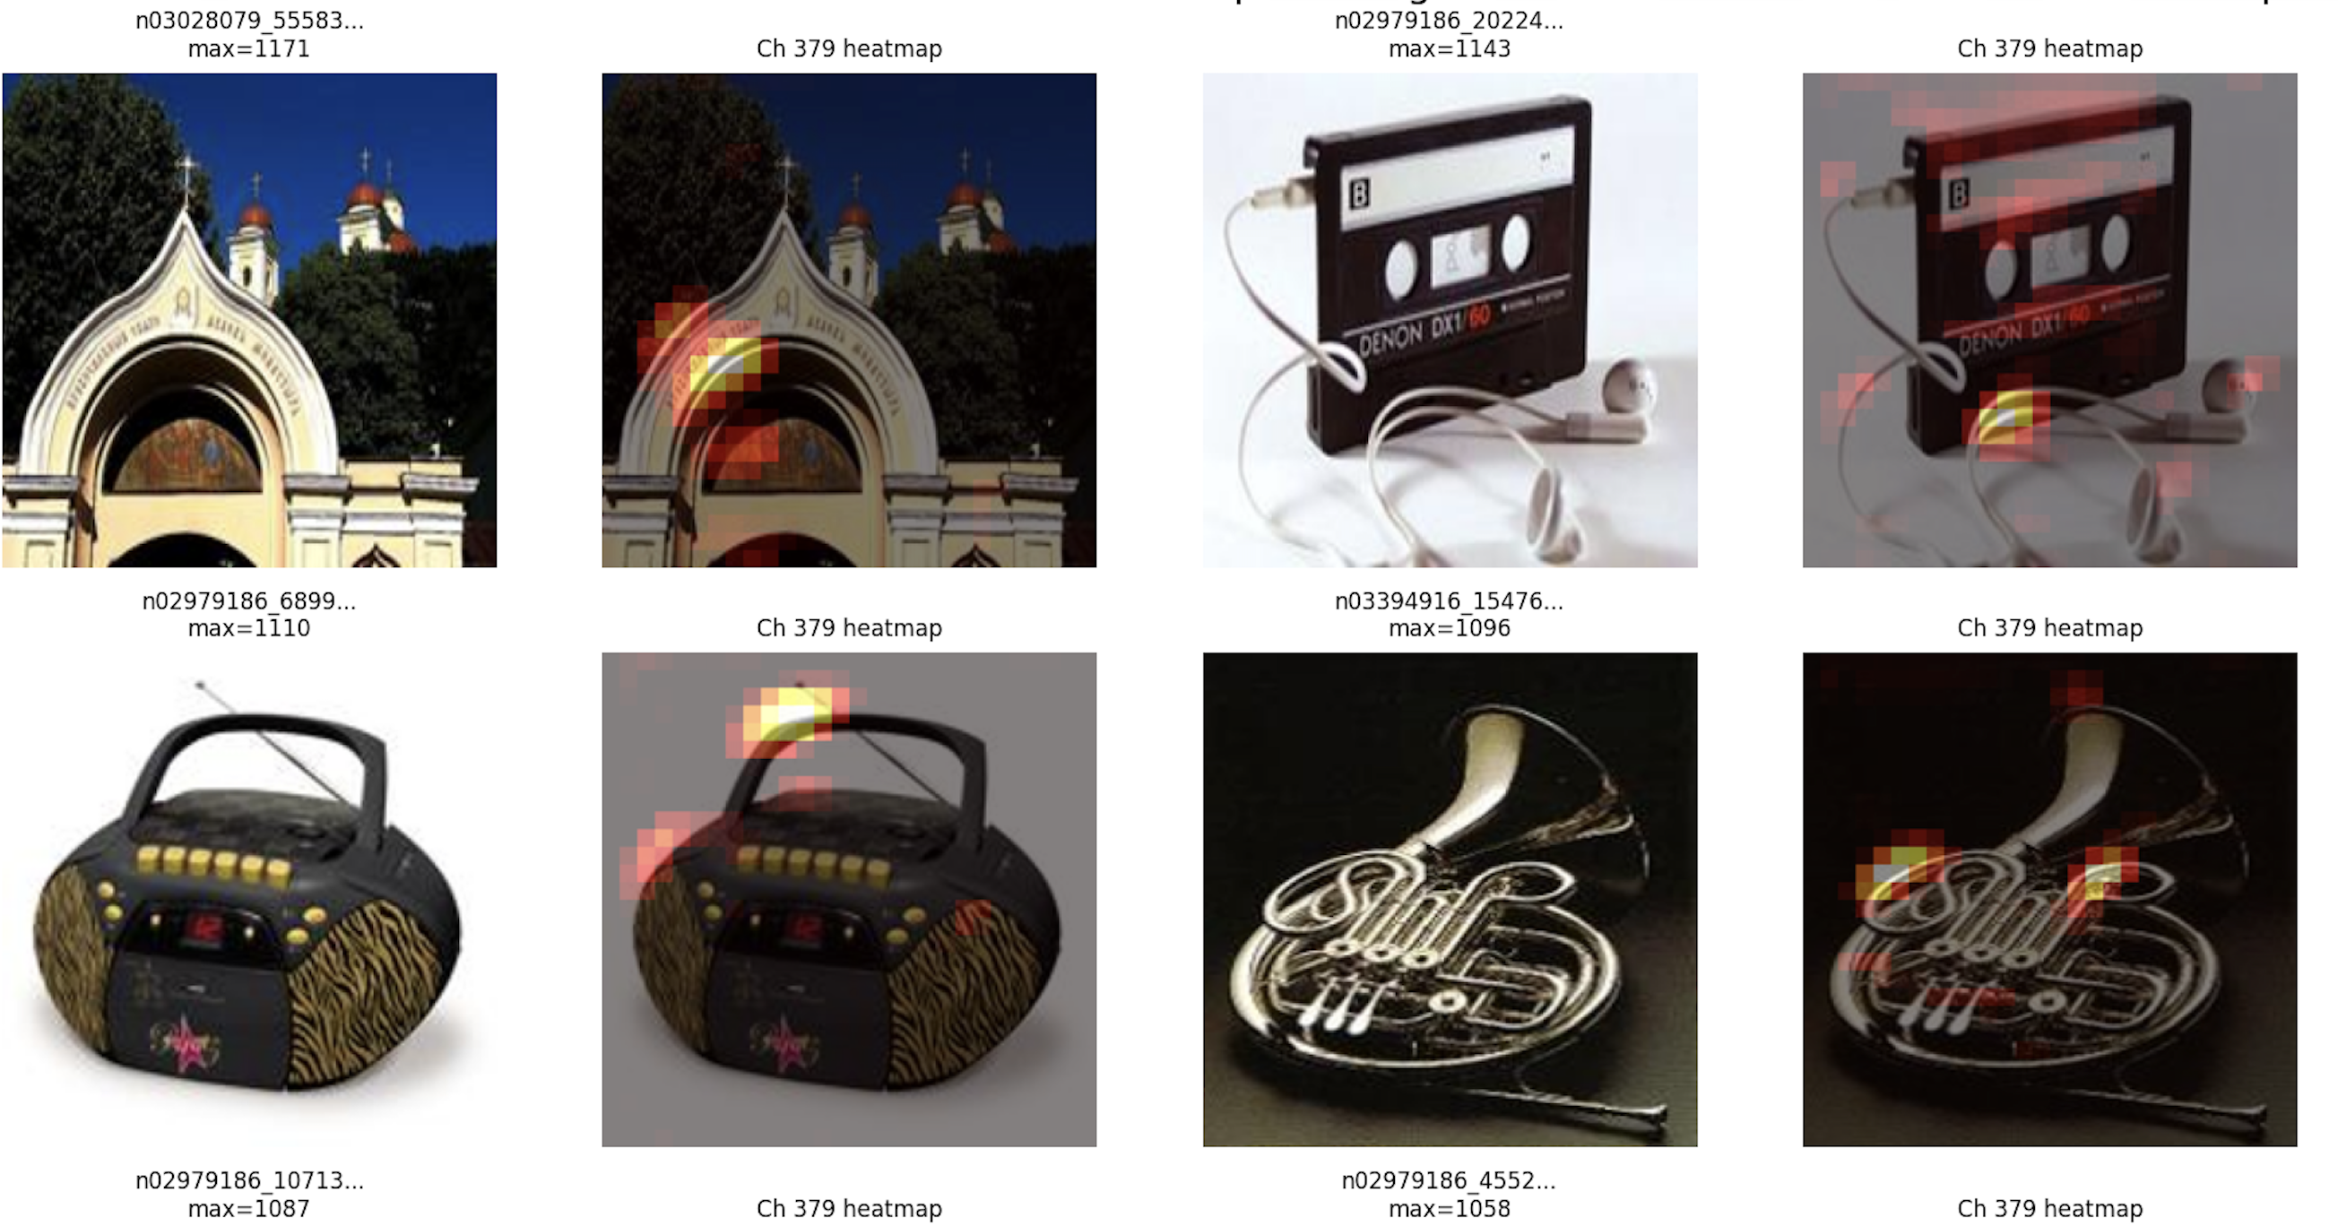
Line of Evidence 2: Dataset Examples
mixed3b:379
Olah et al. (2020)
Top-activating Imagenette images for mixed3b:379 with activation heatmaps (our replication)

Slide 11
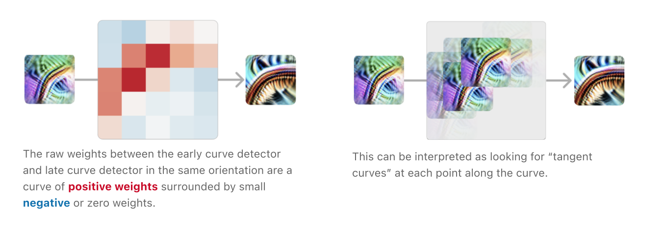
Line of Evidence 5: Implementation
Circuit-based evidence
Examine the weights connecting earlier curve detectors to later ones.
View Layer Connections
From Olah et al. (2020): Weights between early and late curve detectors

Slide 12

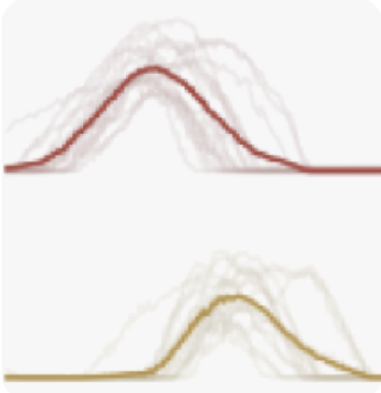

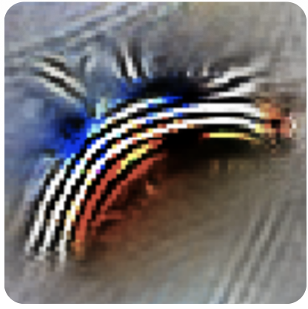
Other Lines of Evidence
Four more arguments: Other lines of evidence for curve detectors.
Synthetic Examples
Joint Tuning
Feature Use
Handwritten Circuits
From Olah et al. (2020)

Slide 13
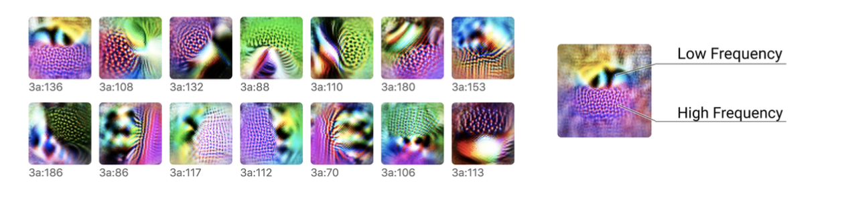
Example 2: High-Low Frequency Detectors
Claim: Some mixed3a neurons respond to boundaries between high- and low-frequency textures
View Layer Connections
From Olah et al. (2020): High-low frequency detectors in mixed3a

Slide 14

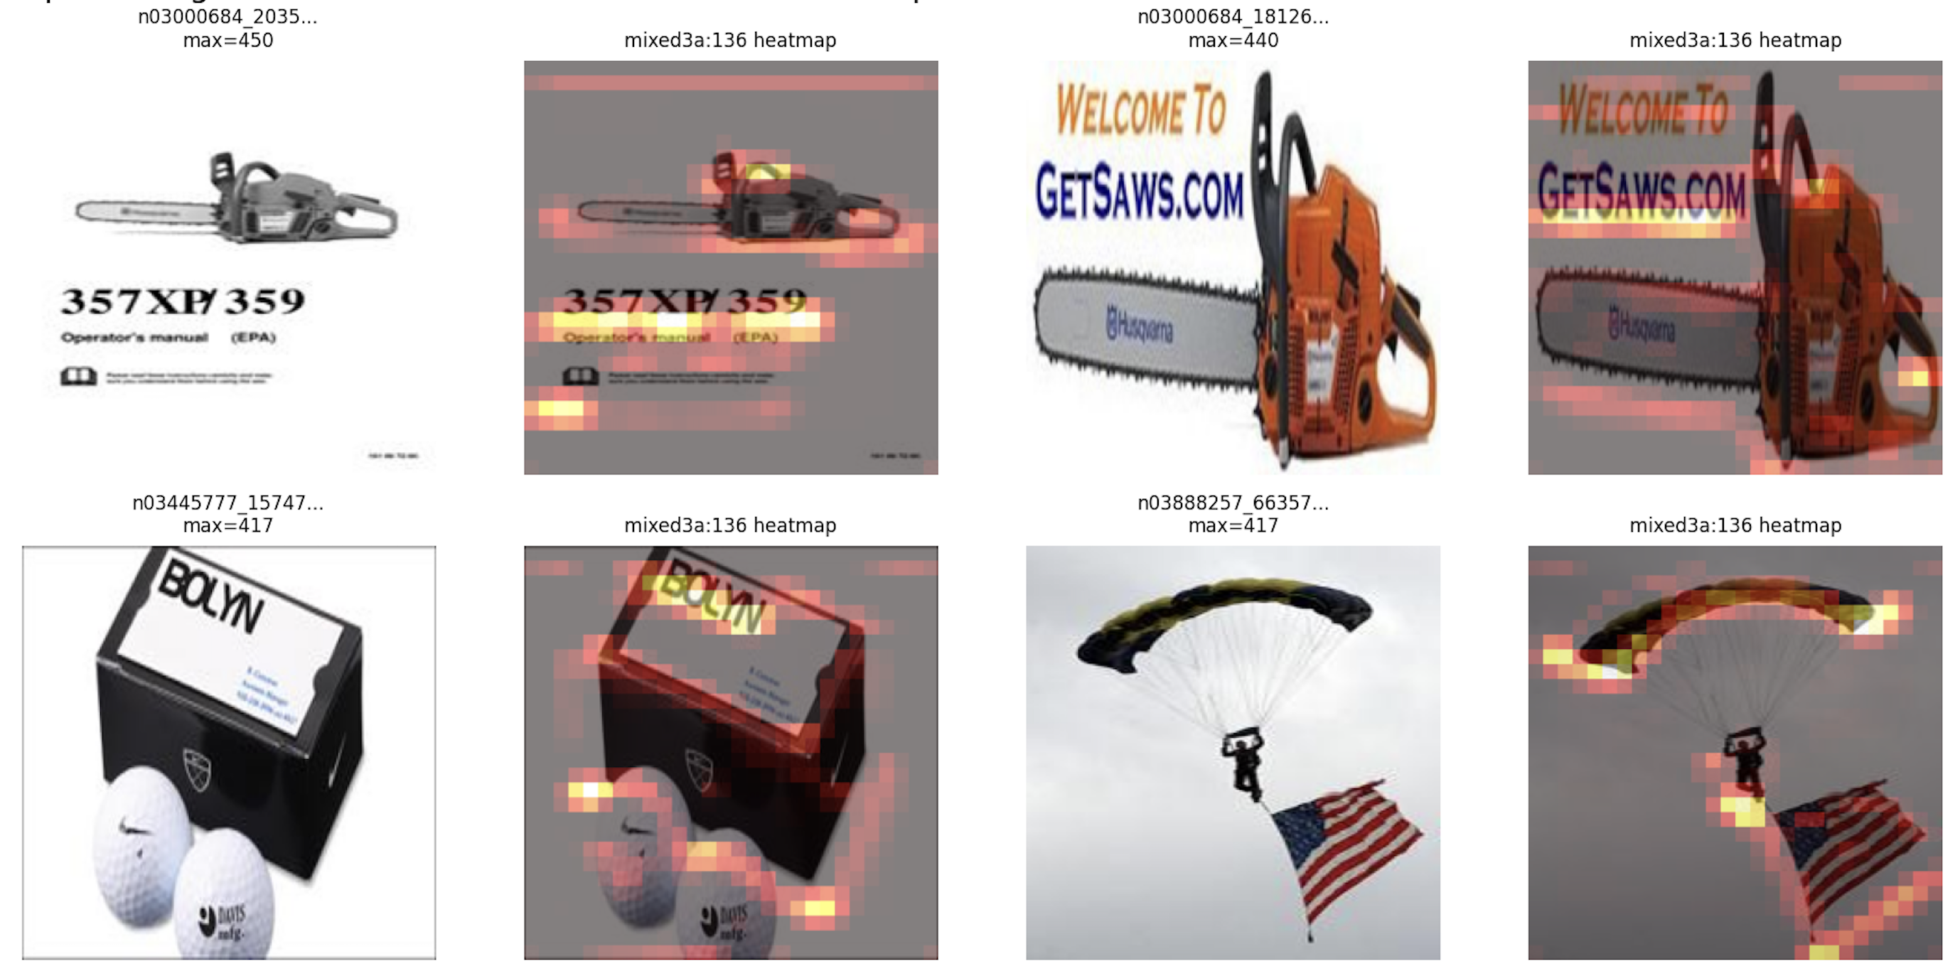
High-Low Frequency: Dataset Examples
mixed3a:136
Olah et al. (2020)
Top-activating Imagenette images for mixed3a:136 with activation heatmaps (our replication)

Slide 15
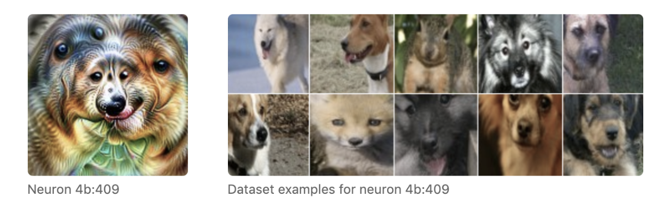
Example 3: Pose-Invariant Dog Head
Claim: Circuit with locality and compositionality. But: this is a simplified cartoon of a densely connected network.
From Olah et al. (2020): Dog head detection circuit

Slide 16
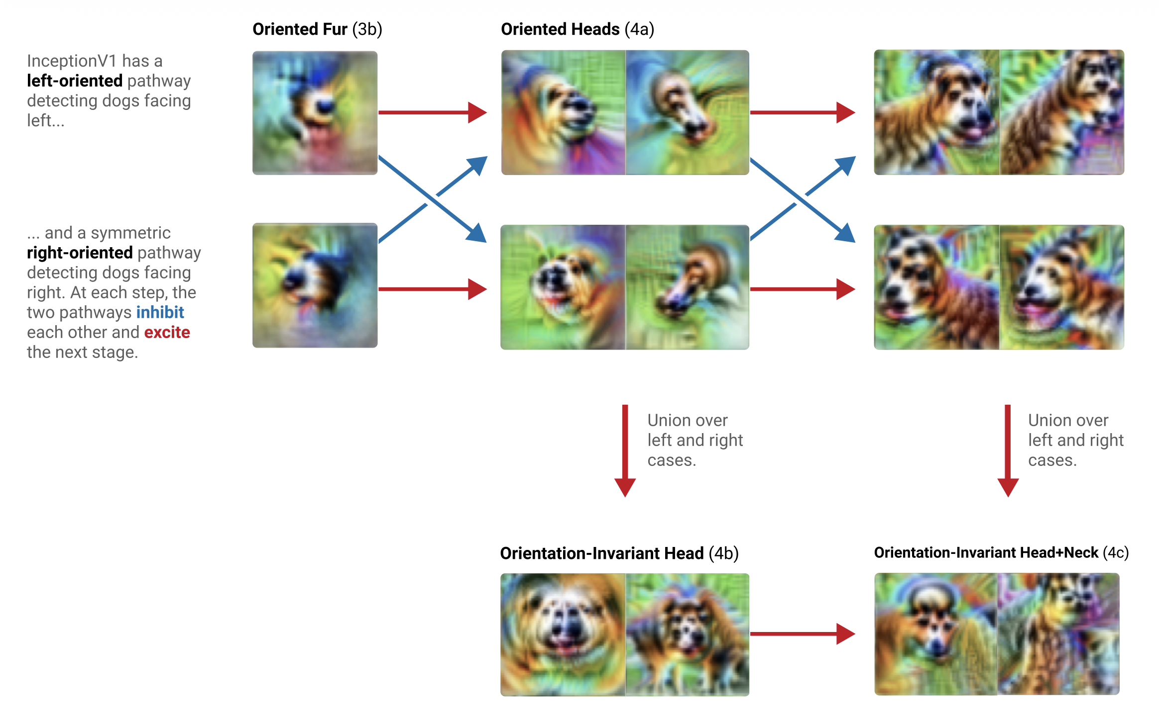
Circuit: The Pose-Invariant Dog Head

Slide 17
Problems with Circuit Framing

Slide 18
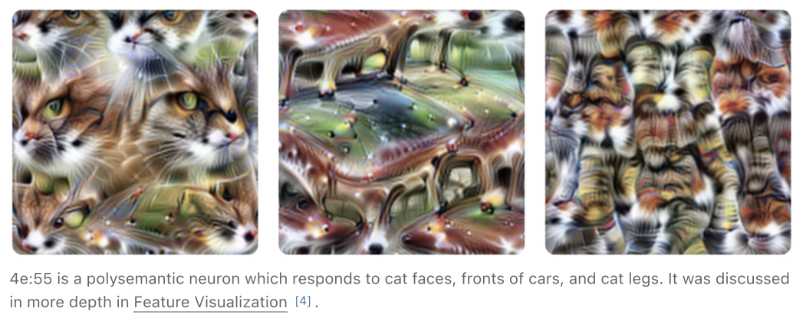
Polysemanticity and Superposition
Olah et al. (2020)
Superposition
Claim: Cars and dogs rarely co-occur, so the model spreads a “car detector” feature across polysemantic neurons.
The paper frames polysemanticity as a “major challenge for the circuits agenda” but doesn’t quantify how prevalent it is.

Slide 19
Interpretability Illusions
Bolukbasi et al. (2021)
Same neuron, different datasets, different “meanings”:
Neuron 221 on Quora: “song titles”
Neuron 221 on Wikipedia: “historical events”
Neuron 221 on BookCorpus: “pulling objects from pockets”
Interpretation reflects dataset-specific clustering, not a global concept.
The distribution-dependence problem
Interpretations are tied to the training data, not global truths about what the neuron computes. Top-activating examples produce consistent patterns within one dataset, but the patterns change across datasets.

Slide 20
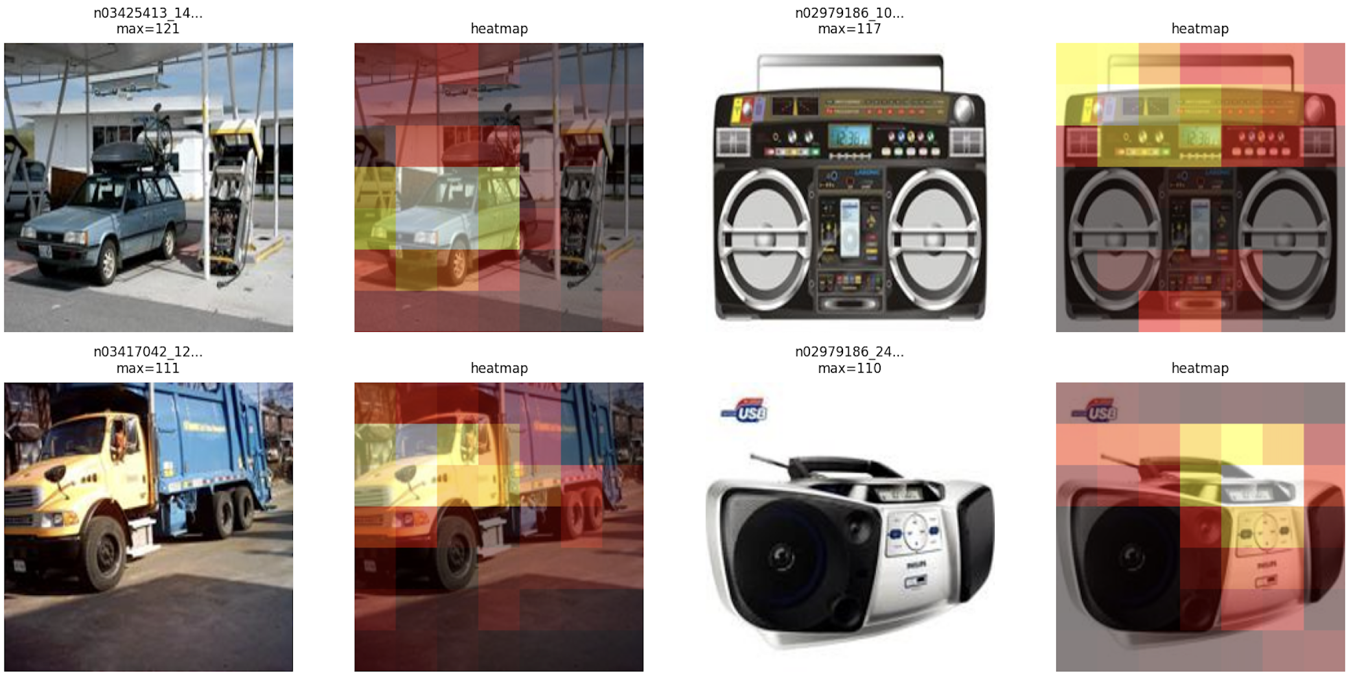
Interpretability Illusion in InceptionV1?
Random 5a feature: Car windows or radio buttons?

Slide 21
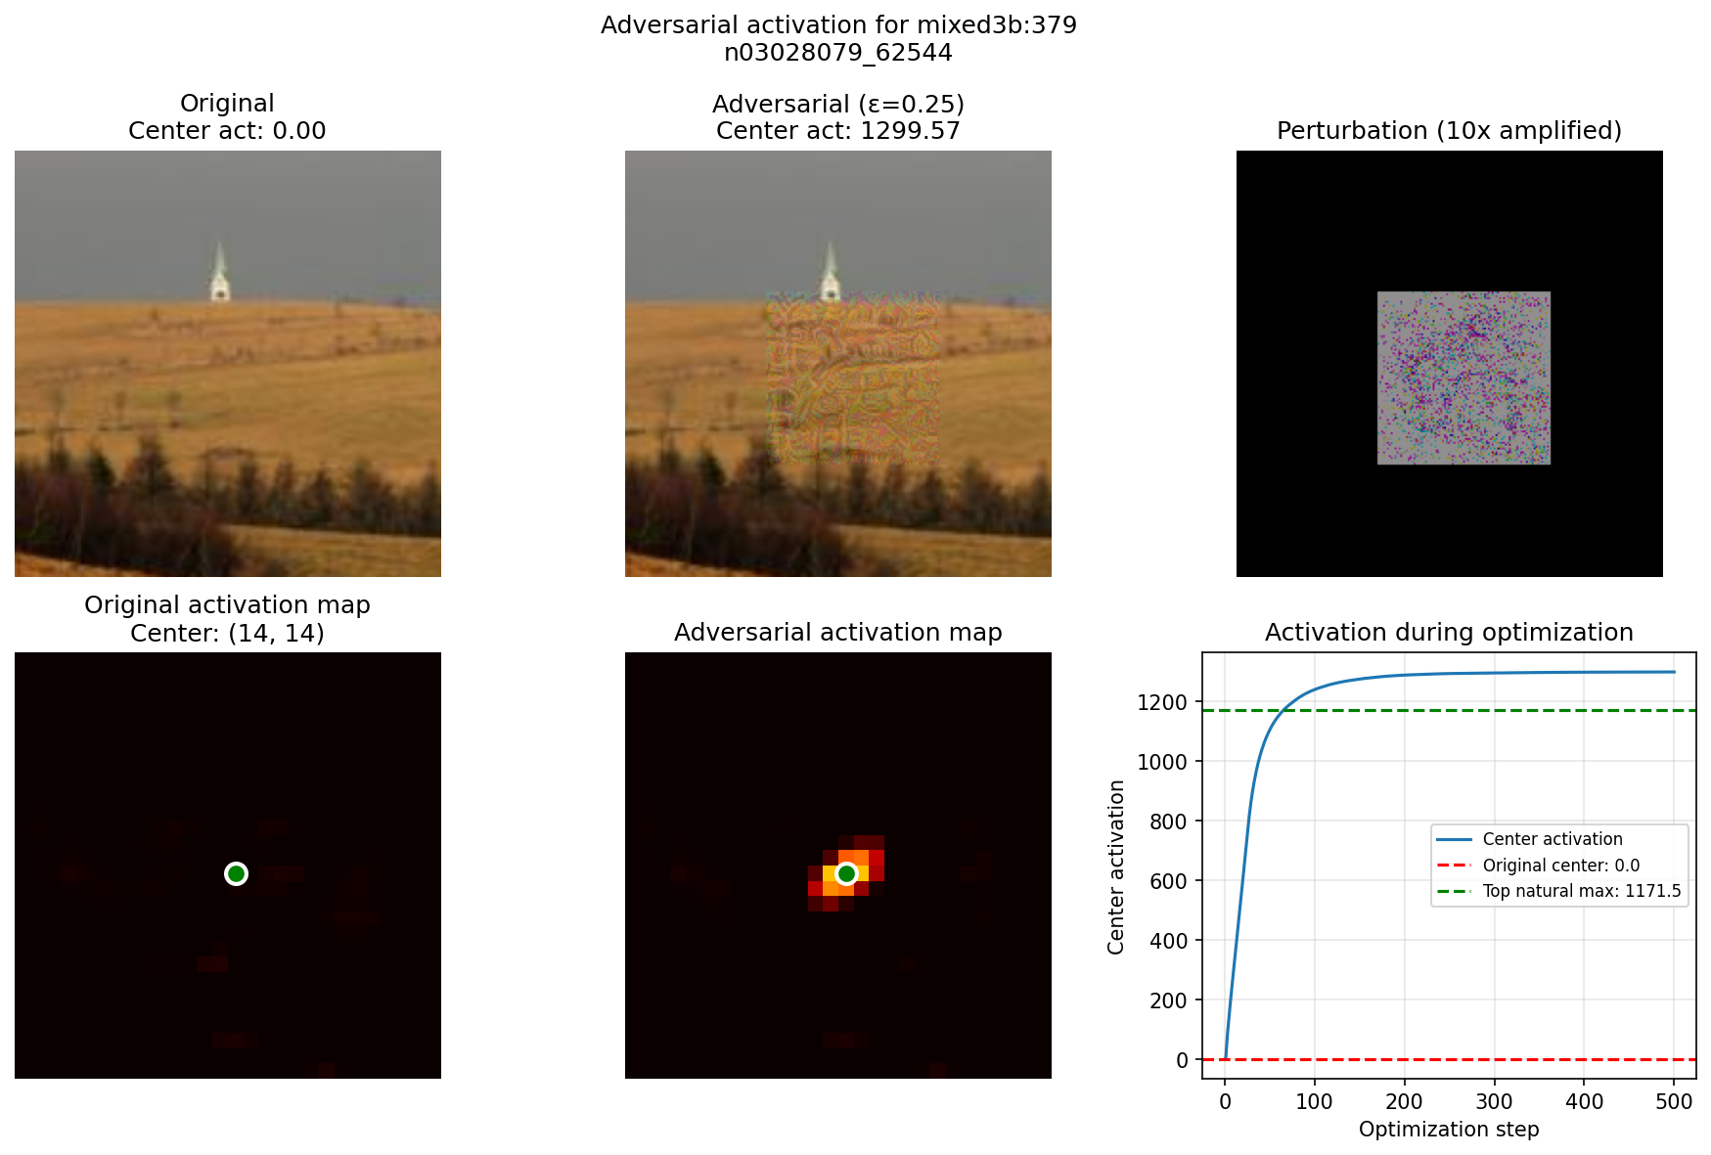
Curve Detectors Off Distribution
Adversarial activation maximization on mixed3b:379 (cf. Goodfellow et al., 2015)

Slide 22
Reverse Engineering or Approximate Description?

Slide 23
Description vs. Reverse Engineering
Reverse engineering
Electronic circuits, spreadsheets: claims about how edits affect downstream computation without reference to any input distribution. Predict behavior on any input by tracing signals.
Approximate description
Neural network “circuits”: claims are always implicitly conditioned on a distribution. Step off-distribution and interpretations break. Statistical regularities, not complete specifications.
Selective Reporting Problem: Paper reports clean, interpretable neurons but doesn’t tell us what fraction are interpretable.
The rhetoric says reverse engineering; the evidence supports approximate description.
Safety implication: If interpretability only gives approximate descriptions that hold on typical inputs, a deceptive model could have “circuits” that look aligned on-distribution but behave differently under deployment.

Slide 24
The Core Assumptions, Revisited
Linearity
Single neurons = linearity + alignment with architectural basis. Superposition: features don’t align with neurons. SAEs accept linearity but drop alignment.
Locality
CNN architecture enforces locality (receptive fields, sequential layers). Transformers break this: attention connects everything; residual stream bypasses layers (Elhage et al., 2021).
Compositionality
Dog head circuit looks compositional, but the actual network is densely connected. Are we finding sparse structure or imposing it?
Properties of the model, or constructs of our analysis?

Slide 25
Where the Field Went Next
Toy Models of Superposition (Anthropic, 2022)
Phase diagram: superposition governed by feature sparsity and importance. When features outnumber neurons and are sparse, superposition is the rule.
SAEs as the proposed fix
Gorton (2024): SAEs applied to InceptionV1 find features neurons miss. Even in this model, neuron-level analysis misses structure.
The narrative arc:
Zoom In (2020) showed something real but cherry-picked → Interpretability Illusion (2021) methodology can mislead → Toy Models (2022) explained why neuron-level analysis is limited → SAEs (2023+) proposed fix for superposition.
Open question: do SAEs resolve the problems or just relocate them? (Weeks 12–13)

Slide 26
Discussion
1. What fraction of a model would need to be interpretable for the circuits approach to be useful for safety?
2. If superposition is the rule, what does “understanding a circuit” even mean?
3. The field moved from neuron-level circuits (2020) to SAEs (2023+). Was the original circuits program a productive dead end, or a wrong turn?
4. Streetlight problem: If we assume locality / compositionality, we’ll only find local / compositional structure. What are we missing?

Slide 27
References
Olah, Cammarata, Schubert, Goh, Petrov & Carter (2020). “Zoom In: An Introduction to Circuits.” Distill.
Szegedy et al. (2015). “Going Deeper with Convolutions.” CVPR.
Hubel & Wiesel (1962). “Receptive fields, binocular interaction and functional architecture.” J. Physiology.
Goodfellow, Shlens & Szegedy (2015). “Explaining and Harnessing Adversarial Examples.” ICLR.
Bolukbasi, Pearce, Yuan, Coenen, Reif, Viégas & Wattenberg (2021). “An Interpretability Illusion for BERT.”
Elhage, Nanda, Olsson et al. (2021). “A Mathematical Framework for Transformer Circuits.”
Elhage, Hume, Olsson et al. (2022). “Toy Models of Superposition.”
Bricken, Templeton, Batson et al. (2023). “Towards Monosemanticity.”
Gorton (2024). “The Missing Curve Detectors of InceptionV1.”
Gorton (2024). “Interpretable Features and Circuits in InceptionV1’s Mixed5b.”
Lindsey et al. (2025). “On the Biology of a Large Language Model.” Anthropic.

