Slide 1
Mechanistic Interpretability
Reading Group
What kinds of interpretability claims are meaningful, useful, and reliable?
UC Berkeley Spring 2026

Slide 2
A strange kind of science
Science studies natural phenomena.
Engineering builds from understood principles.

Slide 3
A strange kind of science
Science studies natural phenomena.
Engineering builds from understood principles.
Modern AI systems built on deep learning are different: we "grow" models through optimization. We have the weights, but we didn't design the mechanisms they implement.

Slide 4
A strange kind of science
Interpretability (in the context of AI) is the project of understanding these grown artifacts — applying scientific methods to things we built but don't comprehend. Weird situation!
Why it matters: curiosity, debugging, trust, safety, and (perhaps) understanding intelligence itself.

Slide 5
What is interpretability?
Three broad approaches:
Input/output explanations ("XAI"): which features mattered for this prediction?
Developmental explanations (“developmental interpretability”): how did mechanisms develop during training?
Internal explanations ("mechanistic interpretability"): what representations, circuits, or pathways produced the output?

Slide 6
What does "mechanistic" mean?
Saphra & Wiegreffe (2024) identify four distinct uses:
1) Narrow technical: causal mechanisms (circuits) validated by intervention.
2) Broad technical: any analysis of model internals, causal or not.
3) Narrow cultural: work from the MI community (Olah, Anthropic, distill.pub).
4) Broad cultural: LLM interpretability research in general.

Slide 7
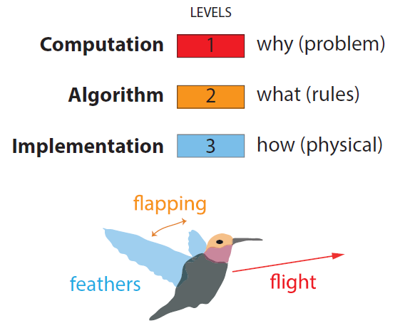
MI as bridging levels of analysis/abstraction
Marr (1982)’s three levels:
MI aims for algorithmic-level understanding: not just what the model does (computational), not just the weights (implementational), but what representations and procedures it uses.

Slide 8
Core assumptions of the research program
To give algorithmic-level explanations, MI generally makes several working assumptions.
These are productive bets — they enable the research program by guiding the selection of problems and solutions.

Slide 9
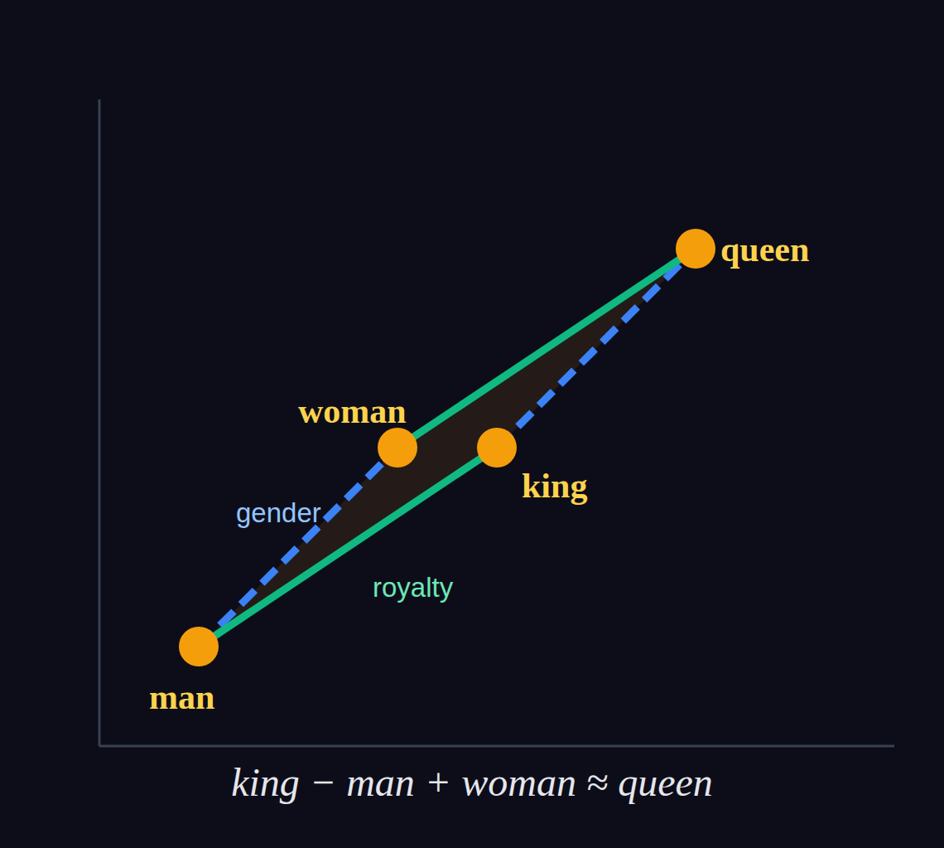
Core assumptions of the research program
1. The Linear Representation Hypothesis
Mikolov et al. (2013): word2vec showed concepts encoded as directions.
Park et al. (2023) formalize this:
"Many high-level concepts are represented linearly as directions in representation space."
This is why linear probes are the default tool — and why steering vectors work.

Slide 10
Core assumptions of the research program
1. Linearity — concepts as directions
2. Locality
Specific computations happen in identifiable components (attention heads, MLP layers, individual neurons or features).
This makes "circuit analysis" possible — tracing information flow through the network.
What would it mean for this to be false? Context-dependence, redundancy, massively distributed computations, etc.

Slide 11
Core assumptions of the research program
1. Linearity — concepts as directions
2. Locality — computations in components
3. Compositionality
Complex behaviors are built from simpler circuits that can be understood independently and then composed.
The hope: understand small pieces, then understand how they combine.
What would it mean for this to be false? Lack of hierarchical structure, etc.

Slide 12
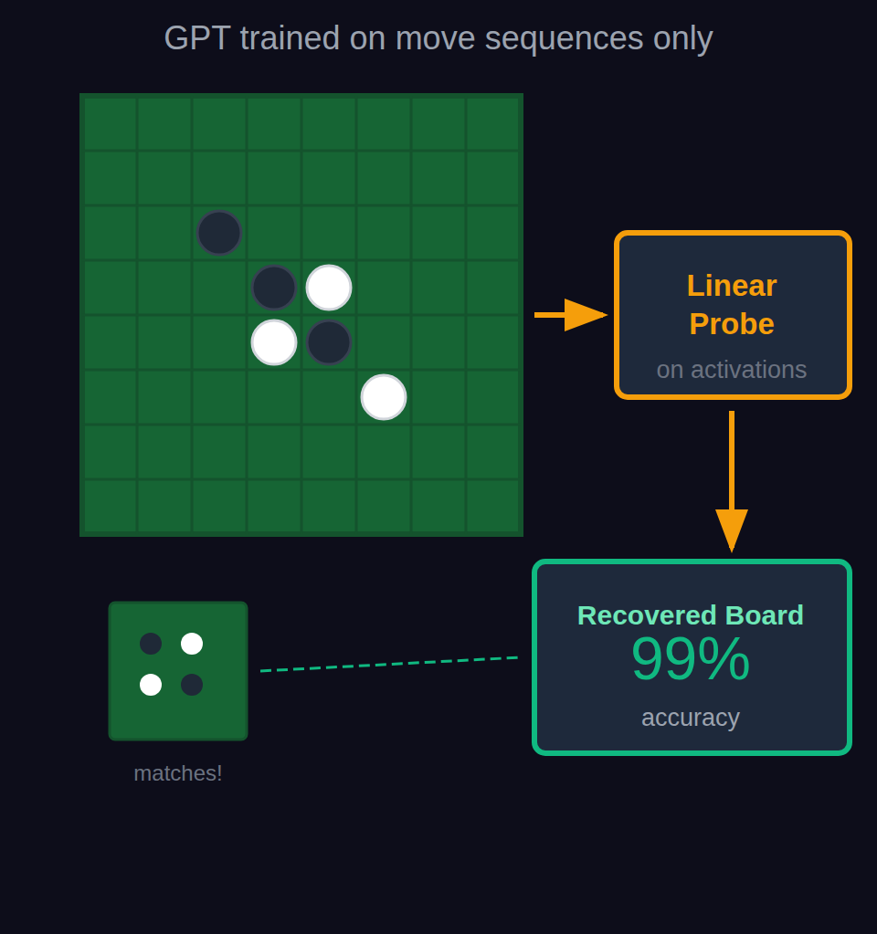
Example: Emergent world models
Li et al. (2023) / Nanda et al. (2023)

Slide 13
Example: Emergent world models
Li et al. (2023) / Nanda et al. (2023)
The setup:
Train GPT on Othello move sequences only.
No board representation in input.
The claim:
Linear probe decodes board state (~99%).
Intervening on probe directions changes behavior.
The model learned an "emergent world model."

Slide 14
Example: Emergent world models
Li et al. (2023) / Nanda et al. (2023)
Claim: emergent world model, decoded by linear probe
Questions to consider:
Is the "world model" in the network, or constructed by the probe?
What would it mean to not have a world model but perform this task successfully?
Could a different probe find a different representation?
What would falsify the claim?
Does this generalize beyond Othello?

Slide 15
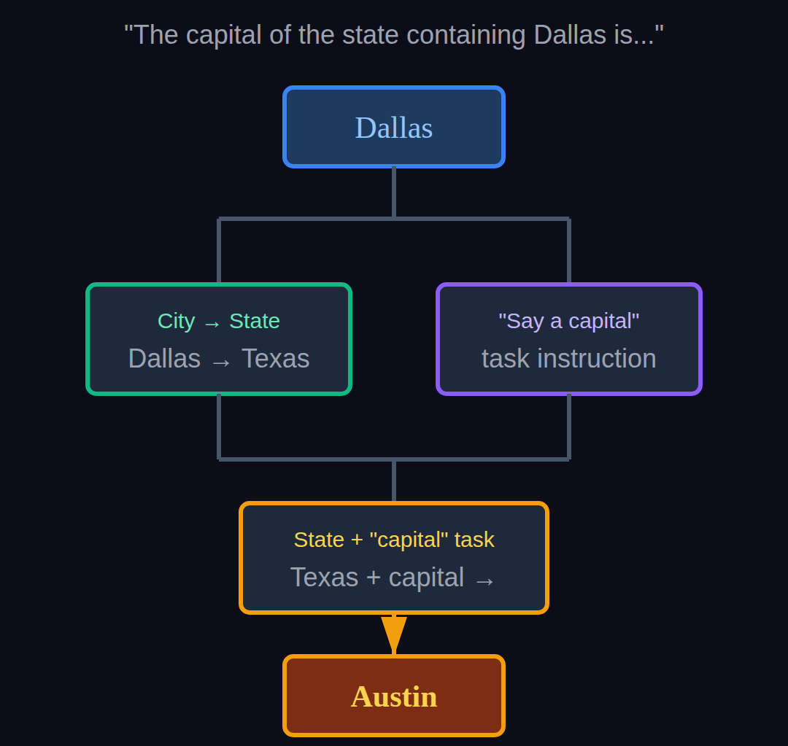
Example: Multi-hop reasoning circuits
Anthropic (2025), "On the Biology of a Large Language Model"

Slide 16
Example: Multi-hop reasoning circuits
Anthropic (2025)
The claim:
Multi-step reasoning can be traced:
Dallas → Texas (geographic lookup)
Texas → Austin (capital lookup)
These compose to produce "Austin."
This is locality + compositionality in action.

Slide 17
Example: Multi-hop reasoning circuits
Anthropic (2025)
Why it matters:
• Frontier work (March 2025) on a production model
• Shows multi-hop reasoning can be traced
• Anthropic frames this as "pre-paradigmatic"
Open: Does this scale? Are circuits "real" or method artifacts?

Slide 18
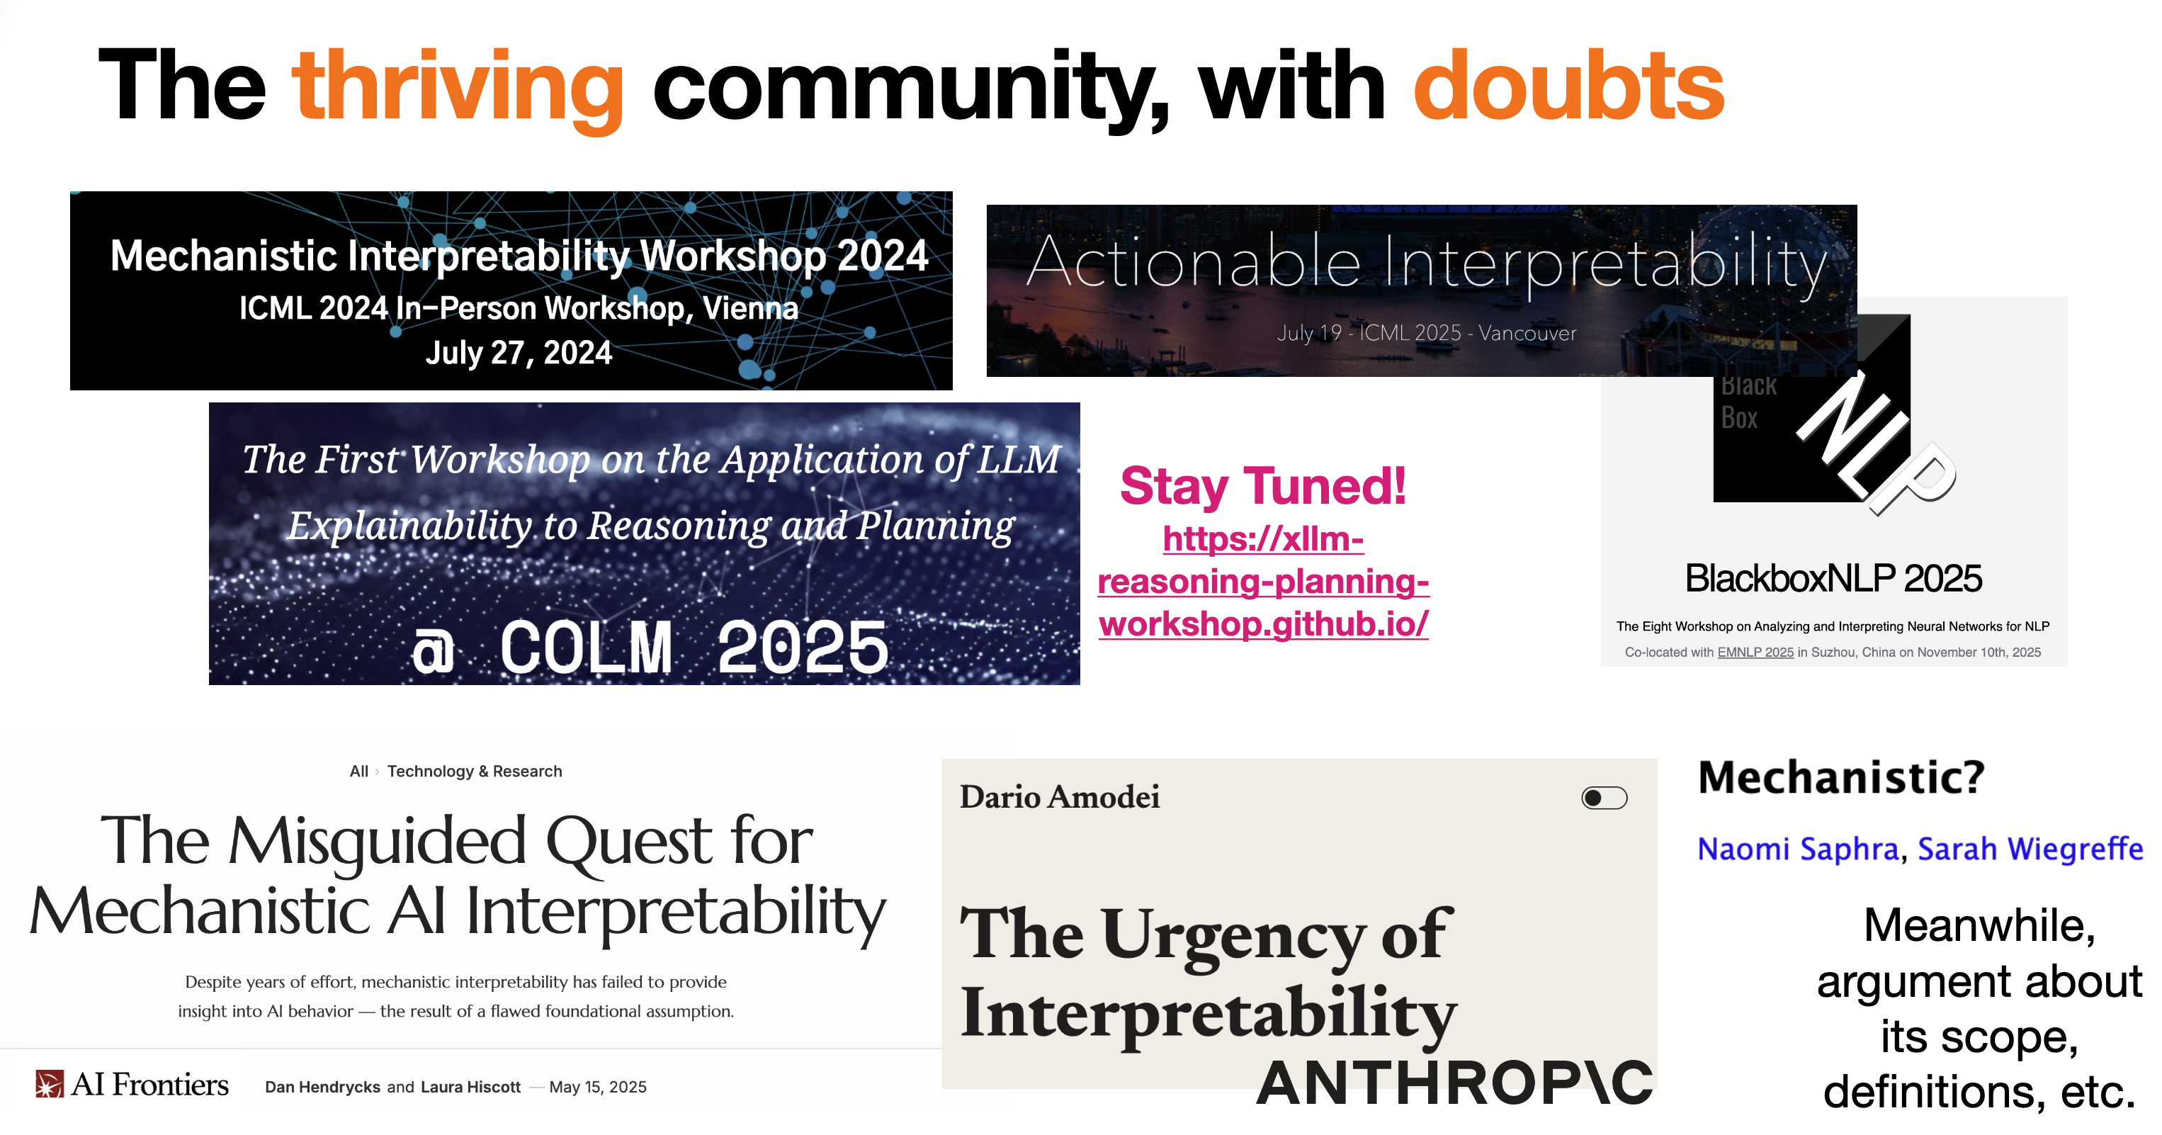

Slide 19
Cautionary tales
Jonas & Kording (2017), "Could a Neuroscientist Understand a Microprocessor?"
Bennett et al. (2009), “Neural correlates of interspecies perspective taking in the post-mortem Atlantic Salmon: an argument for multiple comparisons correction”
The warning:
Methods that find "something" aren't necessarily finding the right thing.
The chip runs actual algorithms we know — and the standard toolkit largely fails to recover them.
For MI: Are we in the same position?

Slide 20
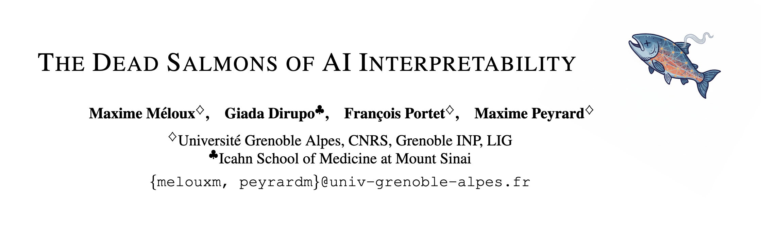
Cautionary tales
Jonas & Kording (2017), "Could a Neuroscientist Understand a Microprocessor?"
Bennett et al. (2009), “Neural correlates of interspecies perspective taking in the post-mortem Atlantic Salmon: an argument for multiple comparisons correction”
The warning:
Methods that find "something" aren't necessarily finding the right thing.
The chip runs actual algorithms we know — and the standard toolkit largely fails to recover them.
For MI: Are we in the same position?

Slide 21
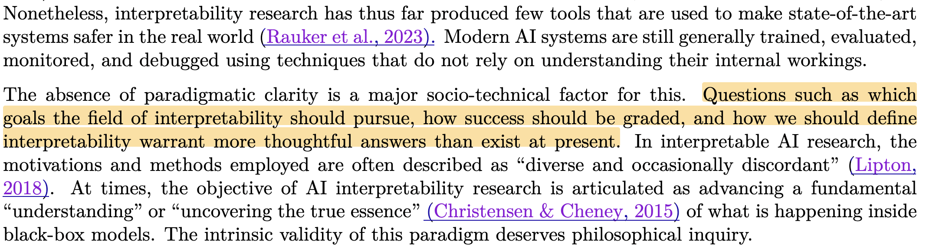
Interpretability as a pre-paradigmatic science
Sharky et al. (2025), "Open Problems in Mechanistic Interpretability"

Slide 22
Interpretability as a pre-paradigmatic science
What "normal science" would look like:
What we often see today:
Shared methods
Standardized evaluation metrics
Benchmarks for reproducibility
Clear units of analysis
Diverse, fast-moving methods
Ambitious narratives, uneven validation
Unclear reproducibility, little incentive
Conceptual slippage

Slide 23
Is interpretability necessarily good?
Which risks can interpretability actually address?
(misuse, societal harms, agentic risks — these may need different tools)
When does it reduce risk vs. increase capability?
(technology as dual-use, offense-defense balance)
Governance gap:
Technical understanding ≠ a deployment decision.

Slide 24
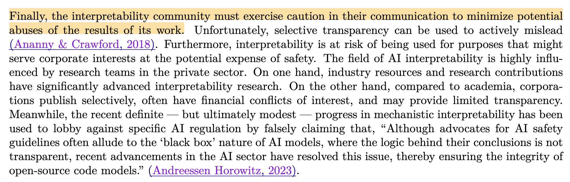
Is interpretability necessarily good?
Sharky et al. (2025), "Open Problems in Mechanistic Interpretability"

Slide 25
Is interpretability meaningful?
Observer dependence:
Could different decompositions be equally valid? Is there a "true" structure?
Illusions from multiple testing:
With thousands of neurons, some will seem interpretable by chance.
The rule-following paradox
Any finite behavior is consistent with infinitely many "rules."
Robustness:
Does the interpretation survive replication, reparameterization, and scaling? How should we think about robustness to distribution shift?

Slide 26
What we'll do
We'll treat interpretability papers as scientific claims:
Identify the paradigm: definitions, primitives, evidence standards.
Interrogate the methodology: hypotheses, controls, causal tests.
Assess reliability: replication, robustness, failure modes.
Track the sociology: which communities, what counts as "new"?
Be explicit about falsifiers: what would make us abandon the story?

Slide 27
Discussion
1. The Othello probe recovers the board state with 99% accuracy.
Does that mean the model "has" a world model? What else could explain this?
2. What sort of interdisciplinary insights are valuable for interpretability?
3. Anthropic says their work is "pre-paradigmatic."
What would it take for interpretability to become a mature science?

Slide 28
References
Saphra & Wiegreffe (2024). Mechanistic? arXiv.
Marr (1982). Vision.
Kuhn (1962). The Structure of Scientific Revolutions.
Mikolov et al. (2013). Linguistic regularities in word representations. NAACL.
Park et al. (2023). The linear representation hypothesis. arXiv.
Li et al. (2023). Emergent world representations. ICML.
Nanda et al. (2023). Emergent linear representations in world models. arXiv.
Anthropic (2025). On the biology of a large language model.
Jonas & Kording (2017). Could a neuroscientist understand a microprocessor? PLoS Comp Bio.
Bennett et al. (2009). Neural correlates of interspecies perspective taking in the post-mortem Atlantic Salmon: an argument for multiple comparisons correction. NeuroImage.
Méloux, Maxime, et al. (2025). The Dead Salmons of AI Interpretability. arXiv.
Sharky et al. (2025), Open Problems in Mechanistic Interpretability. arXiv

